Slide 1
Introduction to Applied Math Projects (AMP)
Ted K

Slide 2
About Me
Major: 3rd year Econ and CS major
Hobbies: Custom mechanical keyboards, music, computer hardware, r/wsb, videogames
Computer Setup: Dual boot Windows and Manjaro
Fun Projects:
Trading on Twitter Sentiment – a theoretical bot that would trade equities based on twitter (did not work well)
Twitch plays Tinder – using the twitch chat service in order to “play” tinder
Interests: Cryptocurrencies, Machine learning BS, consumer tech, cooking & shows
Professional Contact: www.linkedin.com/in/ted-kim/

Slide 3
About Me
www.linkedin.com/in/ted-kim/
www.linkedin.com/in/ted-kim/
www.linkedin.com/in/ted-kim/
www.linkedin.com/in/ted-kim/
www.linkedin.com/in/ted-kim/
www.linkedin.com/in/ted-kim/
www.linkedin.com/in/ted-kim/
www.linkedin.com/in/ted-kim/
www.linkedin.com/in/ted-kim/
www.linkedin.com/in/ted-kim/
www.linkedin.com/in/ted-kim/
www.linkedin.com/in/ted-kim/
www.linkedin.com/in/ted-kim/

Slide 4
About Me
www.linkedin.com/in/ted-kim/
www.linkedin.com/in/ted-kim/
www.linkedin.com/in/ted-kim/
www.linkedin.com/in/ted-kim/
www.linkedin.com/in/ted-kim/
www.linkedin.com/in/ted-kim/
www.linkedin.com/in/ted-kim/
www.linkedin.com/in/ted-kim/
www.linkedin.com/in/ted-kim/
www.linkedin.com/in/ted-kim/
www.linkedin.com/in/ted-kim/
www.linkedin.com/in/ted-kim/
www.linkedin.com/in/ted-kim/
www.linkedin.com/in/ted-kim/
www.linkedin.com/in/ted-kim/
www.linkedin.com/in/ted-kim/
www.linkedin.com/in/ted-kim/
www.linkedin.com/in/ted-kim/
www.linkedin.com/in/ted-kim/
www.linkedin.com/in/ted-kim/
www.linkedin.com/in/ted-kim/
www.linkedin.com/in/ted-kim/
www.linkedin.com/in/ted-kim/
www.linkedin.com/in/ted-kim/
www.linkedin.com/in/ted-kim/
www.linkedin.com/in/ted-kim/

Slide 5
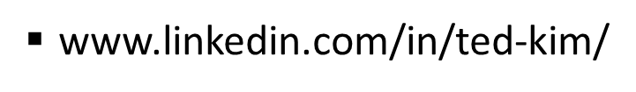
About Me

Slide 6
About Me

Slide 7
About Me

Slide 8
What are we about?

Slide 9
AMP
President of Applied Math (Anubhav) calls us the “Data Science” division of the Applied Math Club
We are not a “pure” data-science club anymore
Applied Math is a much better umbrella term
Sponsored by the math department – but we haven’t been given RSO status yet
Originally going to parade around as a data-science RSO
My friend told me I could get backed by the Math department if I joined him

Slide 10

If you just want to do data-science
Take classes and do Kaggle exercise
Data-science is an incredibly complex field where amateurs will struggle to do things well without consult from professionals
Currently there isn’t a lot for you to do
Creating and analyzing new/interesting datasets requires some engineering/some level in the engineering process

Slide 11
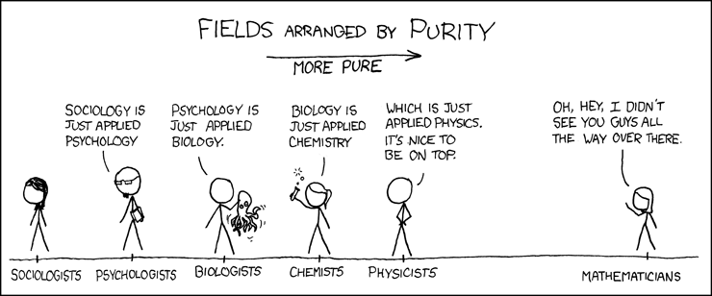
What is “Applied Math”?
Munroe, R. PURITY . Retrieved from xkcd.com/435/

Slide 12
What is “Applied Math”?
What isn’t applied math?
Applied Math Club == Free pass to do whatever we want

Slide 13
RSO Landscape/Ideal Candidates

Slide 14






RSO/Club Landscape
Does Projects and Stuff
Fun & Interesting

Slide 15
RSO/Club Landscape
Does Projects and Stuff
Fun & Interesting
US?

Slide 16
Personal Philosophy
“Applying” to join clubs is the dumbest thing ever
Standards are way too high and create this elitist culture
Seems punishing to freshman who just want to learn about a particular subject or field
Why did I make you apply?
Basic screening mechanism
If you couldn’t put in the time/put in the effort to BS an app, odds are you can’t do what we plan to do

Slide 17
The Ideal Candidate
DOESN’T need to be a Stat/Computer Science/Math god
I have pretty low standards
Learning on the job is a fun part of the job anyways
Annoying soft skills like communication, time management are going to be also important
Comfortable with learning on the job/consulting papers/google/stack exchange/quora.
Odds are we’re going to have to be doing a lot of learning on the job
This is completely normal when doing anything new/research intensive
Need to be able to commit
If you get a real-role in a project – packing out is going to be seriously detrimental to progress

Slide 18
The Responsibility Hierarchy
More Important
Classes
Jobs/Recruiting
Your Commitments to AMP
Personal Well-being
Other commitments
Less Important

Slide 19
Self Selection
If you can’t really do these things (and I doubt ALL of you can)
Maybe you should hold off on doing projects for now
Why am I trying to dissuade you?
Finishing projects from scratch require careful planning and division of work
Having people not do their portions because of other commitments and work really hinders progress and hurts morale
Having people just drop out of the portions because things got busy is incredibly destructive to progress

Slide 20
What it takes to get a project done
There is a reason why project development related-topics have books and classes on them
It’s hard
Passion
Passion generates interesting project ideas and helps you stay engaged
Grit
Passion alone is not enough to sustain a project
It takes discipline to finish all the hard parts of a project

Slide 21
Right Now
We can only afford to do ONE project
Not enough resource (people, time, and money)
Ideal completion date would be by the end of winter quarter
α

Slide 22
The “Endgame”
Independence & Concurrency
Projects run by other club members
Need funding – we can get more funding my displaying competence
Having projects be successful can bring in more interested parties (students, researchers, professors, etc)
β
γ
ρ
σ
χ

Slide 23
The Engineering Stack/Pipeline Work
High-level programming languages
TLDR: python
Rationale: we are too busy with other things too justify the time and energy needed to develop tools from the ground up
Benefits

Slide 24
Sample Pipeline Projects

Slide 25
Facebook Bot Detector
Facebook bots seem to be getting smarter
Try to use statistics or other features of bot users to more intelligently detect bots
Example of human level bot detection: No Mutual Friends, Suspicious profile pictures, etc

Slide 26
Engineering: Facebook Crawler
Engineering Concepts
Piping/Scraping data using public APIs and alternative means
Building apps to get access to user facebook data?
Creating Facebook Bots to collect more information (legality pending)
Creating datatypes representing Facebook users

Slide 27
Applied Math: Graphs and Stats
Math Concepts
Graph theory/Graphing algorithms
Using Statistics or some ML BS to determining probability of being a bot through profile features (ex: # of pictures, #of friends, etc)
+ Much More

Slide 28
Guitar Bot
What if we could hook up a series of motors and aritifical fingers to a computer to play the guitar?
Sure there are very realistic electronic/replicated guitar sounds, but what if we just want that authentic acoustic feel?

Slide 29
Engineering: Guitar Interfacer
Engineering Concepts
How to program with motors through low-level means or through open-source means
Physically engineering a system of motors that can strum different parts of a guitar
Implementing a series of motors to replicated fingers
Translate data revolving chords, notes, strumming pattern into machine readable formats.

Slide 30
Applied Math: Physics and…?
Math Concepts
Understanding the physics behind pitches and stuff
Perhaps we create an interpreter that takes popular songs into our engineered format
We have a potential database of music in a playable formatted that could be used in some NN – to produce new songs? Provide dynamic accompaniment to singing?

Slide 31
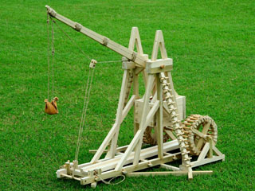
Trebuchet

Slide 32
Other Potential Projects
Uchicago Building Traffic Stats
Most popular Routes on campus
Polling the campus on various stuff
Using an inappropriate amount of computing resources for random stuff
Hosting a math-related hackathon
Scanning Venmo feeds to do some “insightful data”
Going to Uncommon hacks as a group
Using school resources to build a custom server (In the works)
Hosting a Data science Hackathon

Slide 33
Open to Suggestions as well!

Slide 34
Questions? Contact me through email (tedkim97@uchicago.edu) or FB

Slide 35
How do I get involved?

Slide 36
Timeline
Official “starting points” to potential projects will begin as soon as we finalize themes
[Right now] Only one project will be done at a time
Projects will be picked by a quasi democratic process
Members will be able to vote on their personal favorite/top three projects they would like to see
(hopefully) projects will be done in a series of code sprints (imagine doing your cs project the night before kind of stuff)

